Slide 1
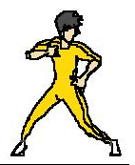
Click here to play

Slide 3
YOU WIN

Slide 4
YOU LOSE

